Slide 1

Ruby on Rails

Slide 2
About today…
Ruby on Rails
Layouts
Partials

Slide 3

Introduction to Layouts and Partials
Layouts
Templates for consistent page structure
Partials
Reusable pieces of view code

Slide 5
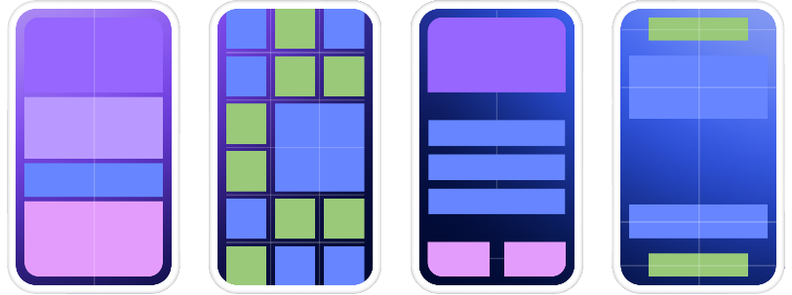
What are layouts
Purpose
Provide a consistent structure for web pages by defining a common template that
can be used across multiple pages
Functionality
They often include the basic HTML structure, such as <html>, <head>, and <body>
tags, along with common elements like headers, footers, and navigation bars
Usage
Layouts are used to wrap around the content of different pages, ensuring that the
overall look and feel of the website remains consistent
Location
app/views/layouts

Slide 6
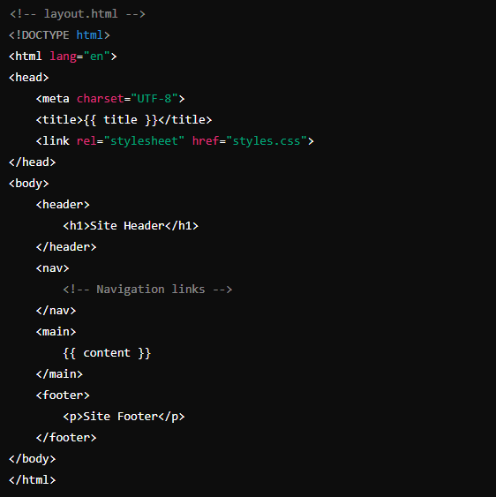
Base Template
Provides a structure for your webpage
Has a placeholder for the page title
Defines the basic layout with a header,
navigation, main content area, and footer

Slide 7
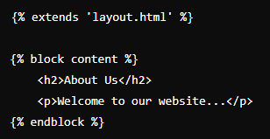
Child Template
Extends the base template (layout.html)
Defines the content to be inserted into the
main section of the base template
Template Inheritance and Content Injection
The {% extends 'layout.html' %} line in about.html tells the template engine that about.html is a child of layout.html
The {% block content %} in about.html matches the placeholder {% block content %} in layout.html
When the template engine processes about.html, it replaces the {% block content %} section in layout.html with the content defined in about.html

Slide 8
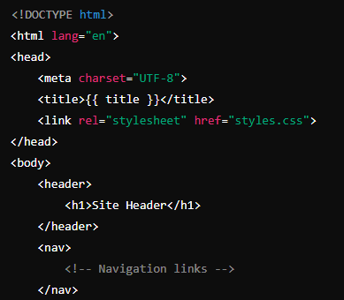
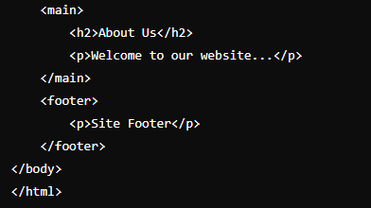
Final Look

Slide 9
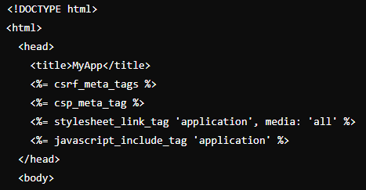
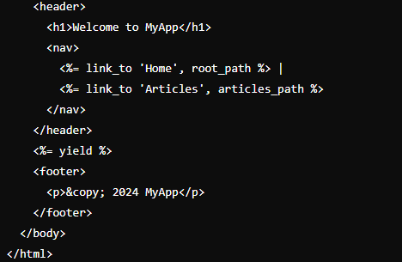
Creating a Layout
Default Layout
application.html.erb
Basic Structure
Rails automatically uses application.html.erb if it exists

Slide 11
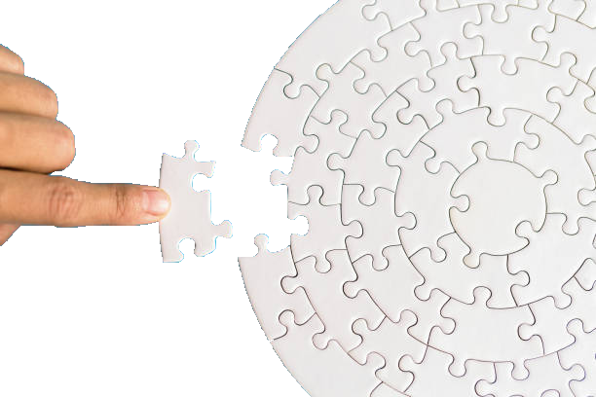
What are Partials
Role
Reusable components or fragments of code
Purpose
Encapsulate small, repeatable elements that can be included in various places
within a layout or other templates
Functionality
Serve specific purposes and can be used multiple times across different pages
Usage
Included within layouts or other templates to avoid code duplication

Slide 12
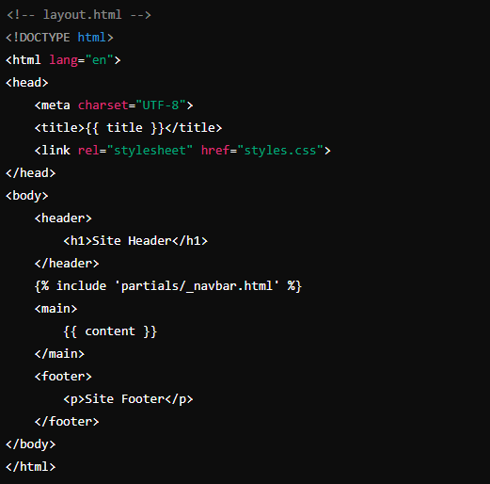
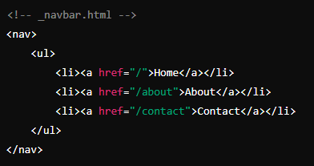
Example

Slide 13


Slide 14

What is the main purpose of a layout in Rails?
Where do you typically place layout files in a Rails application?
Which method is used to include a partial in a view?
What file extension should a partial template have?
What is the purpose of the yield keyword in a Rails layout?

Slide 15

Task 1
Include a layout and partial in your app

